Slide 1
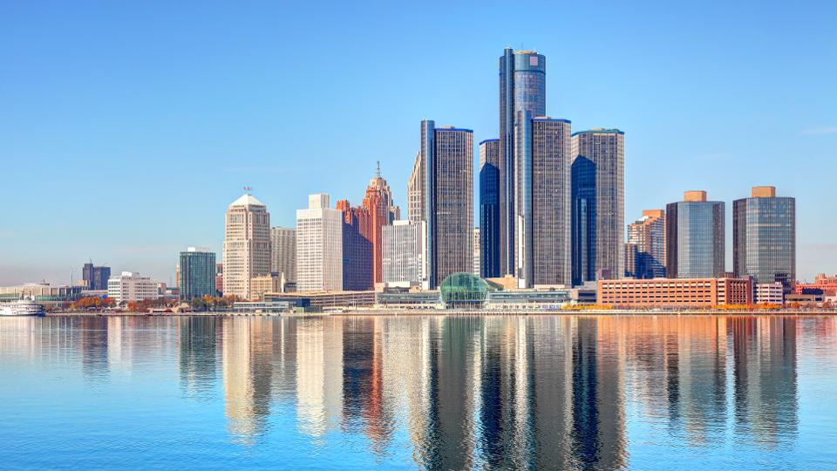
Detroit – The Motor City
Colegiul National de Informatica “Grigore Moisil” Brasov
Profesori coordonatori: Dragus Daiana, Stoica Catalina
Elev: Caba Matei

Slide 2
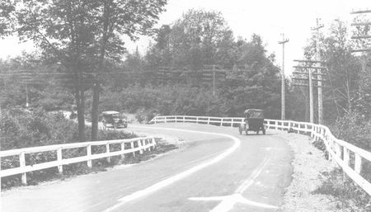
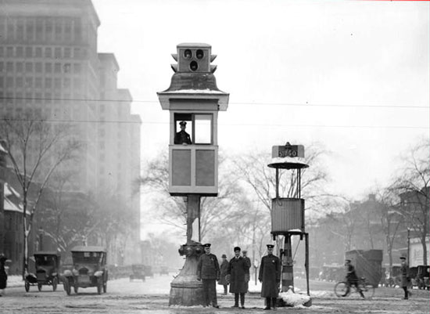
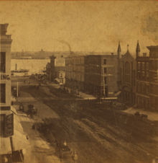
Did you know?
The first tri-color 4-way traffic light was invented in Detroit 100 years ago, in 1920
The first road was laned in Michigan in 1911
The first paved road in America is Detroit’s M-1

Slide 3
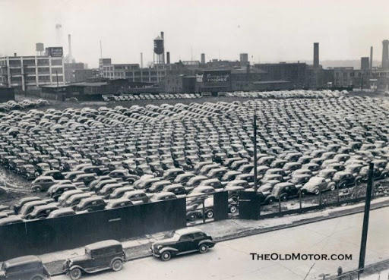
How it all started?

Slide 4
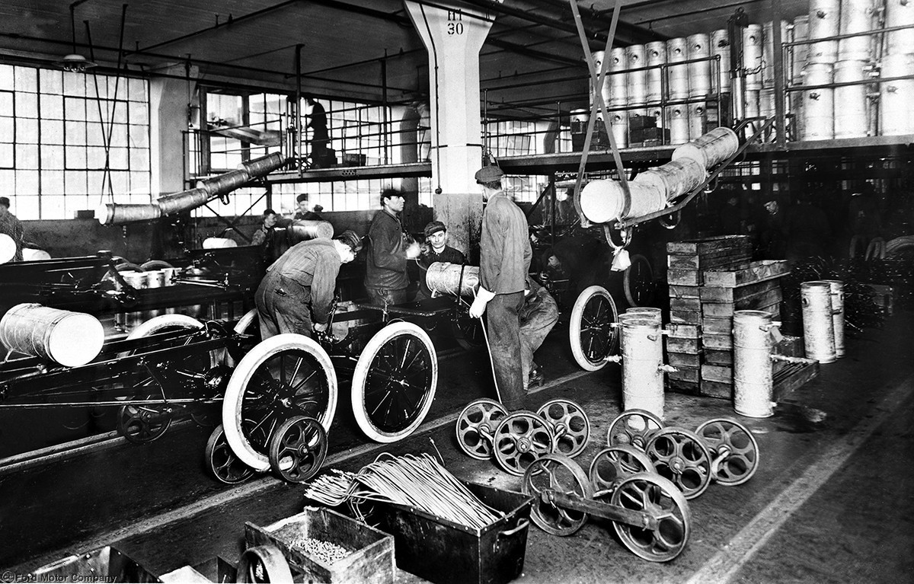
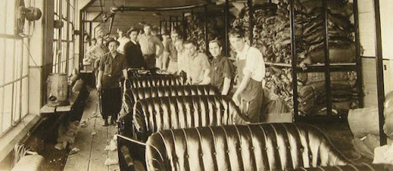
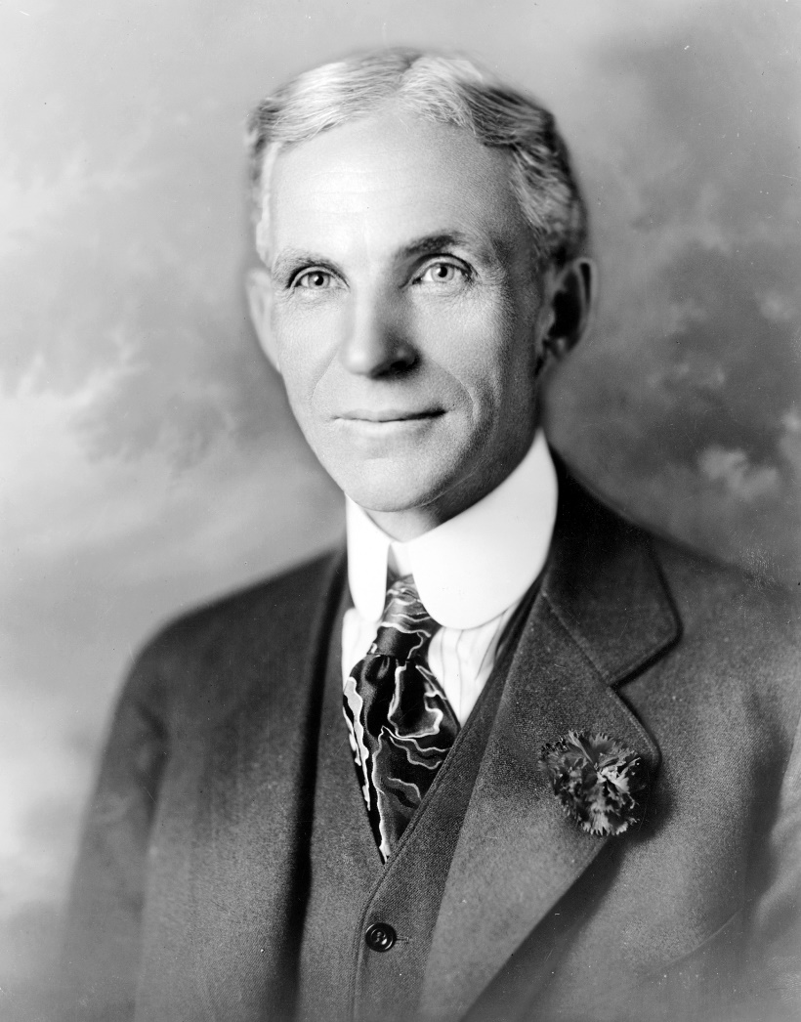
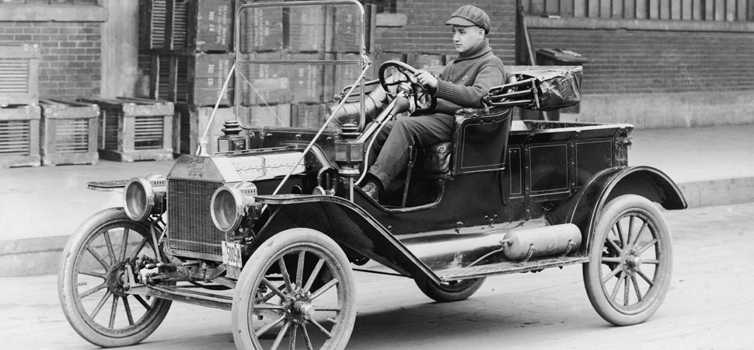

Slide 5
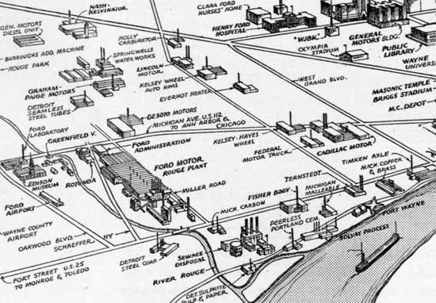

Slide 6
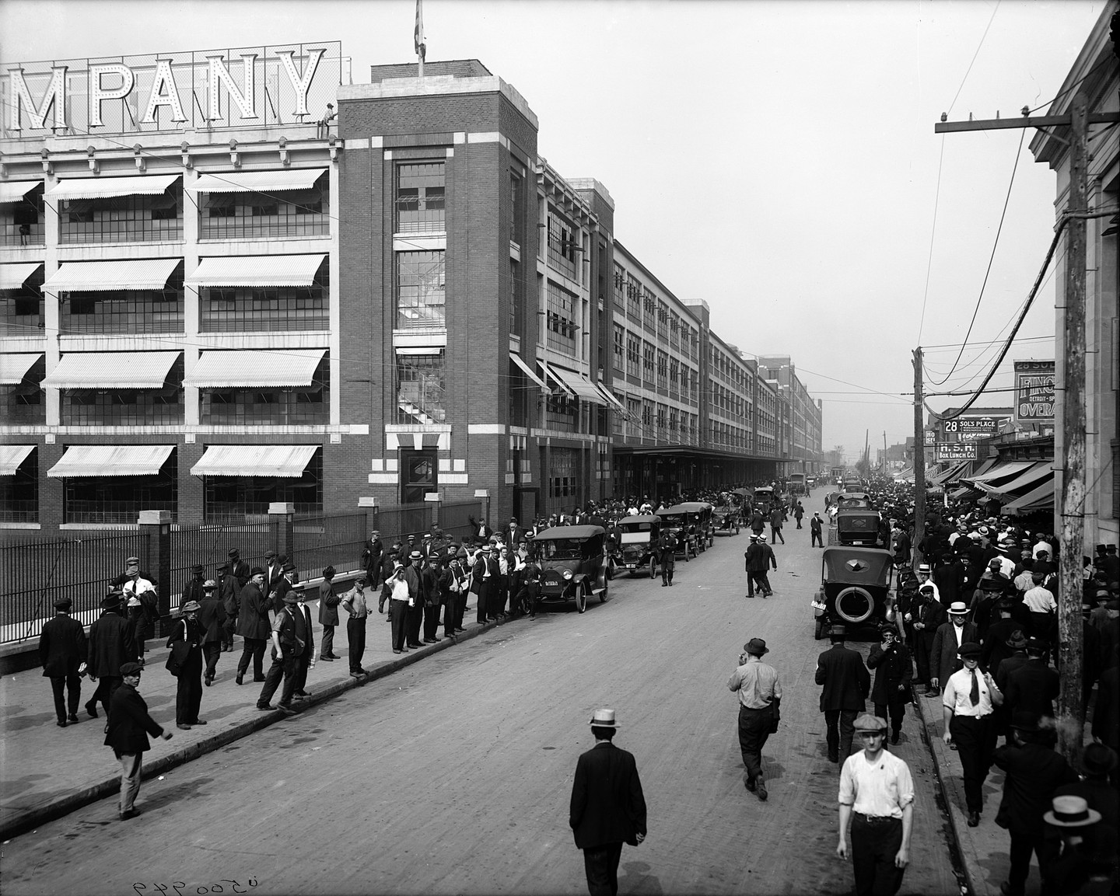

Slide 7
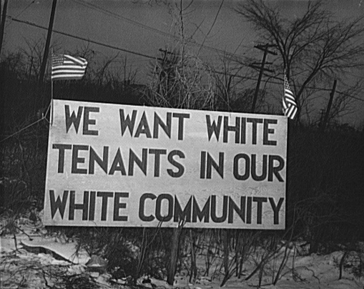
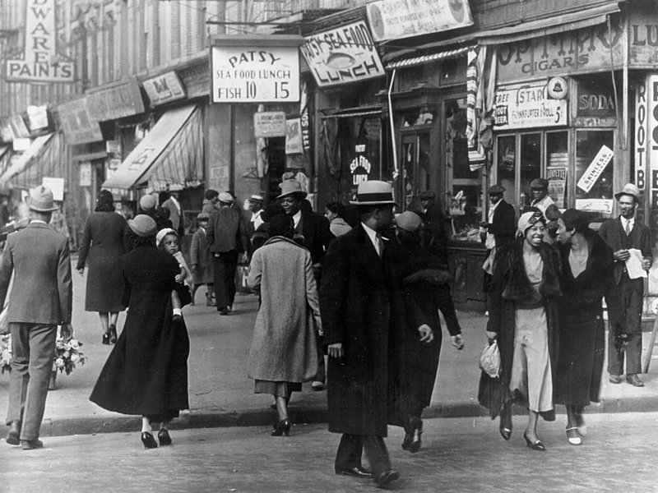
The Great Migration
Brought rural African-Americans from the South

Slide 8
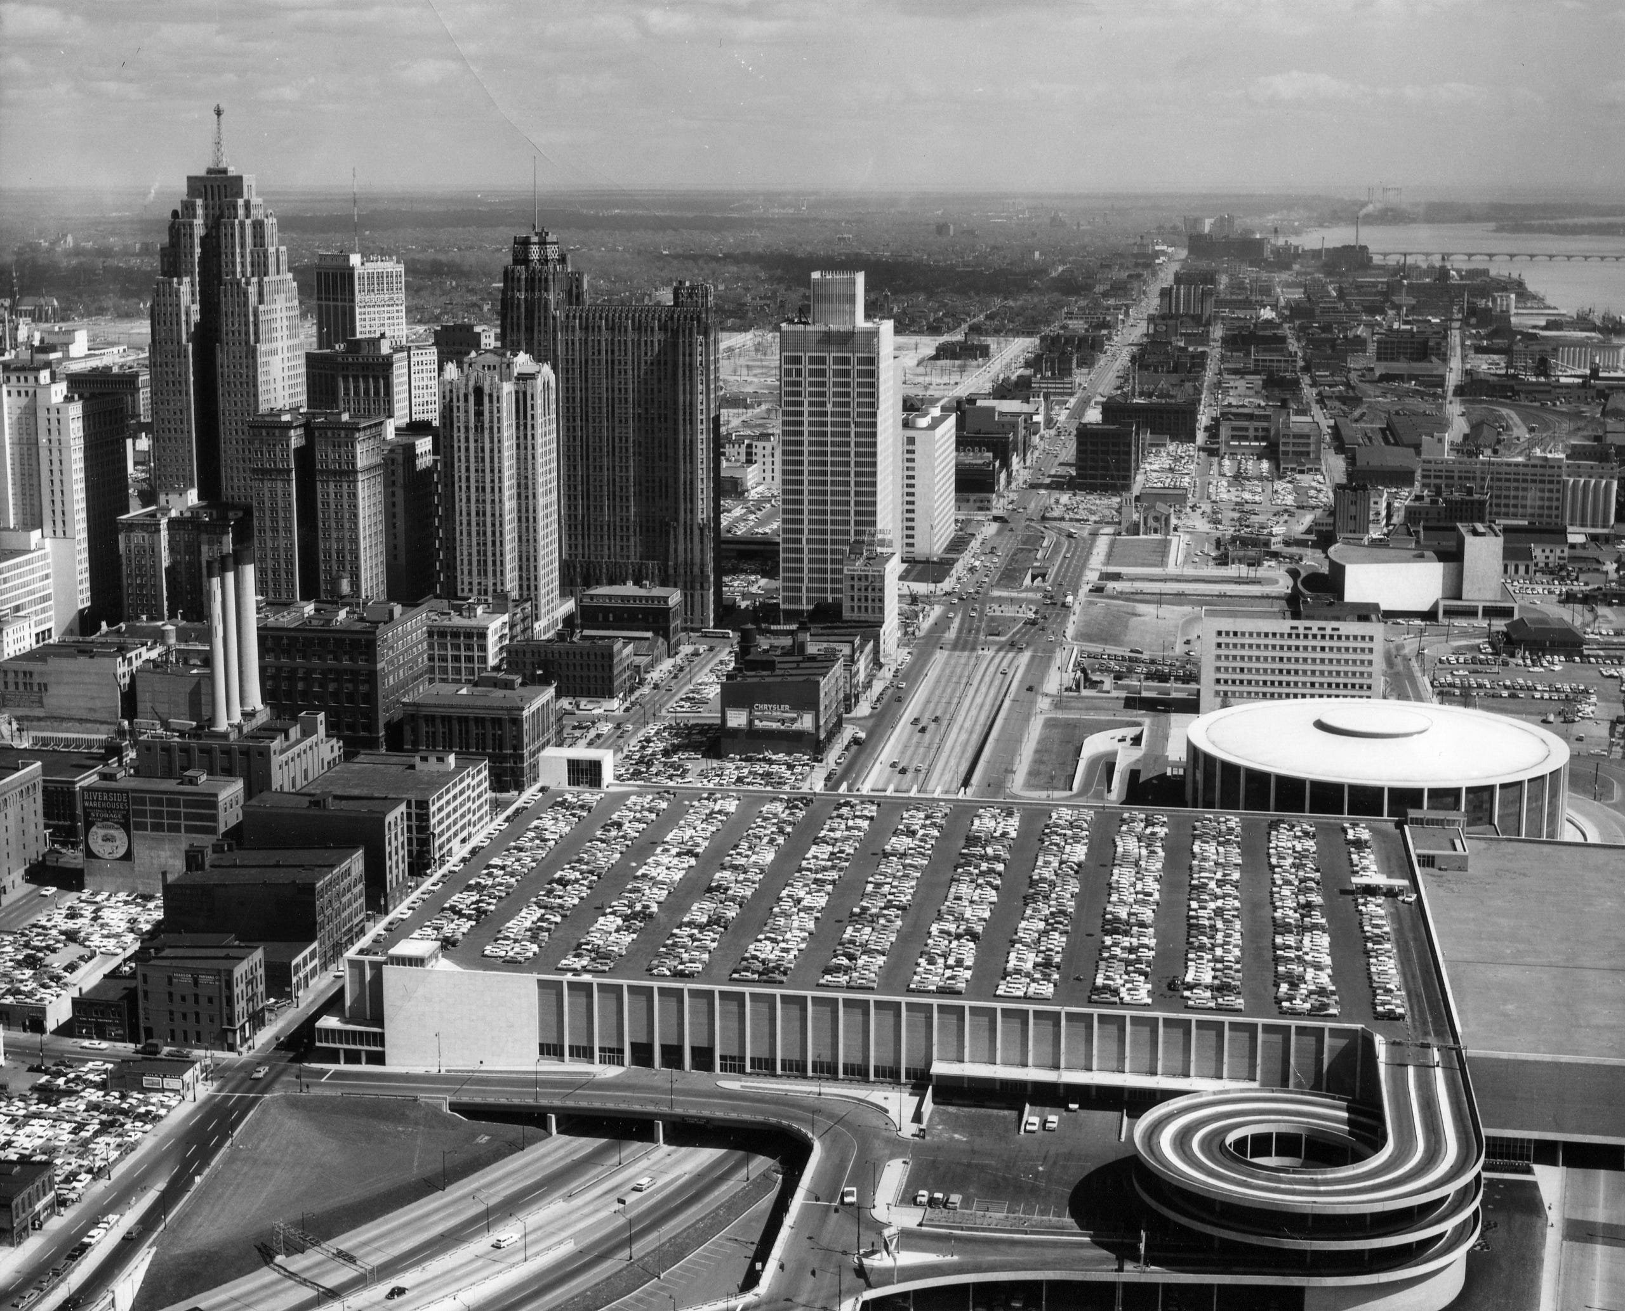
At its peak population of 1.849.568 in the 1950, the city was the 4th largest un the US, before its decline period.

Slide 9
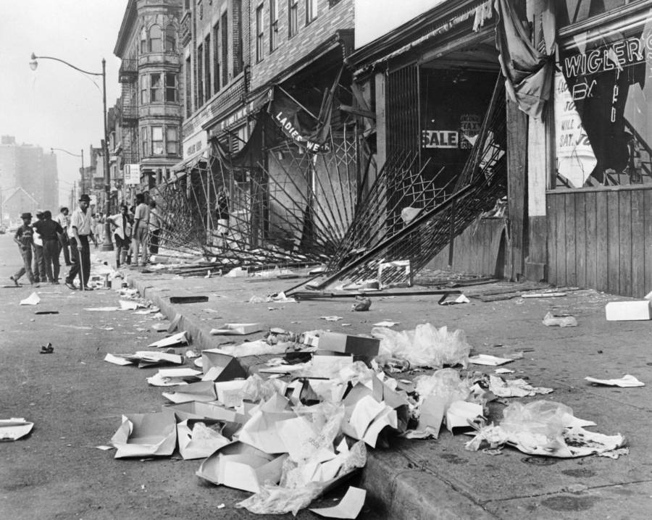
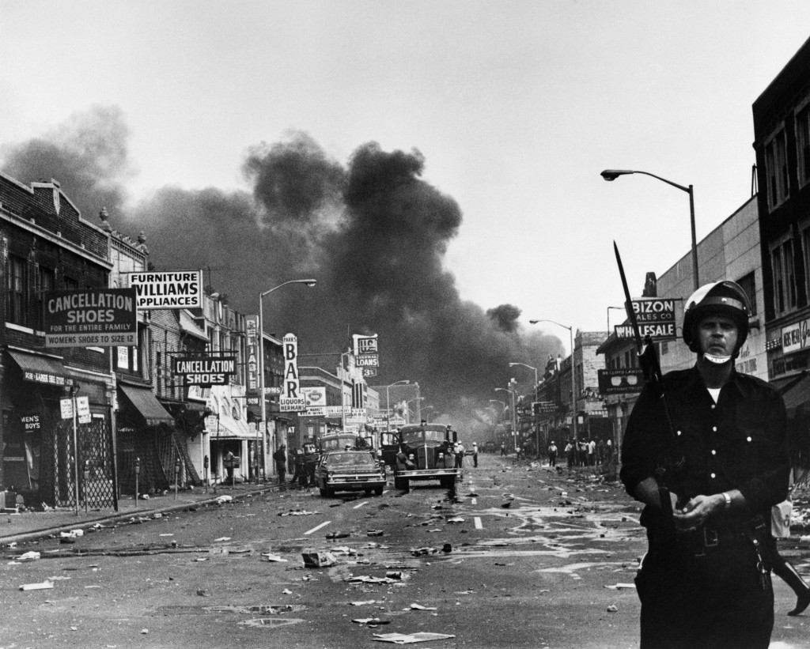
1967 Detroit Riot
43 deaths
2000 buildings destroyed
Thousands of businesses closed permanently or relocated to safer neighborhoods

Slide 10
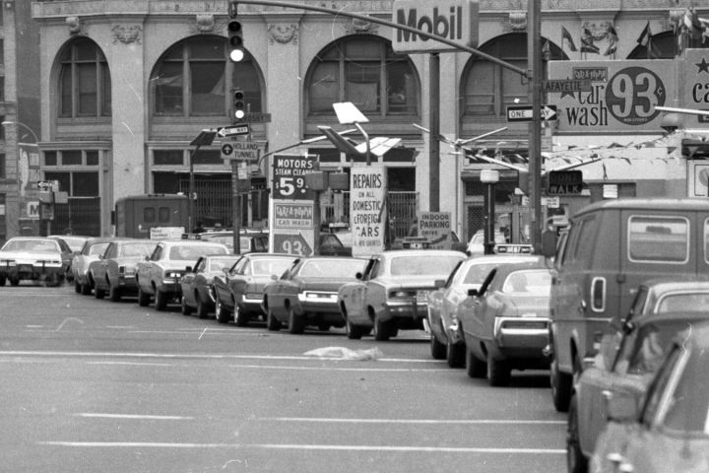
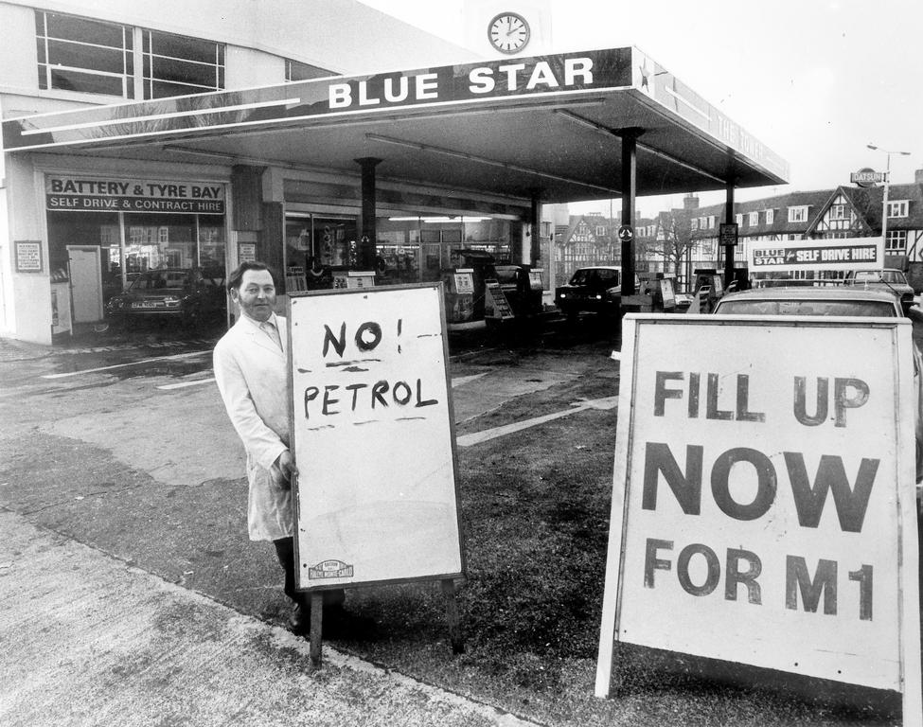
The gasoline crises of 1973 and 1979
By 1980, domestic luxury cars with a 130-inch (3.3 m) wheelbase and gross weights averaging 4,500 pounds (2,041 kg) were no longer made.

Slide 11
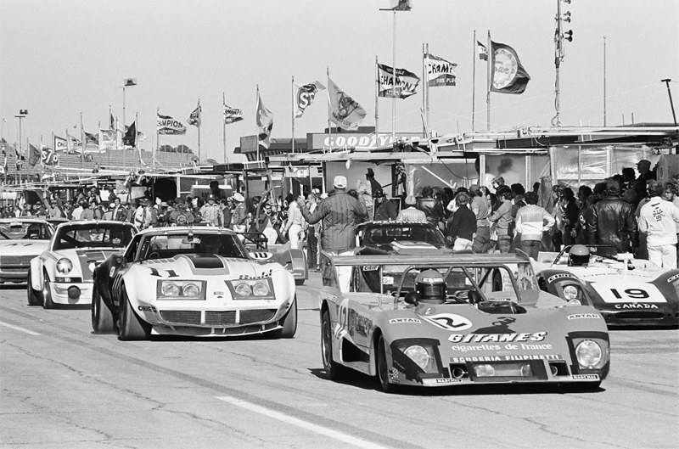
Big races were cancelled
In 1974, NASCAR reduced all race distances by 10%
The 24 Hours of Daytona and the 12 Hours of Sebring race were cancelled.

Slide 12

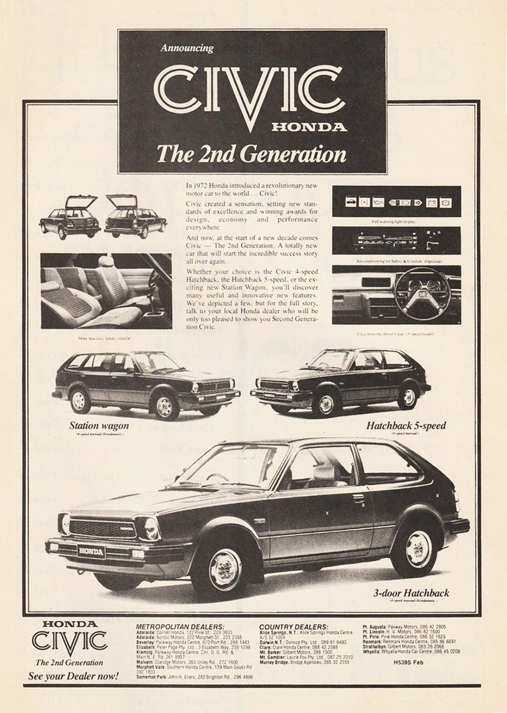
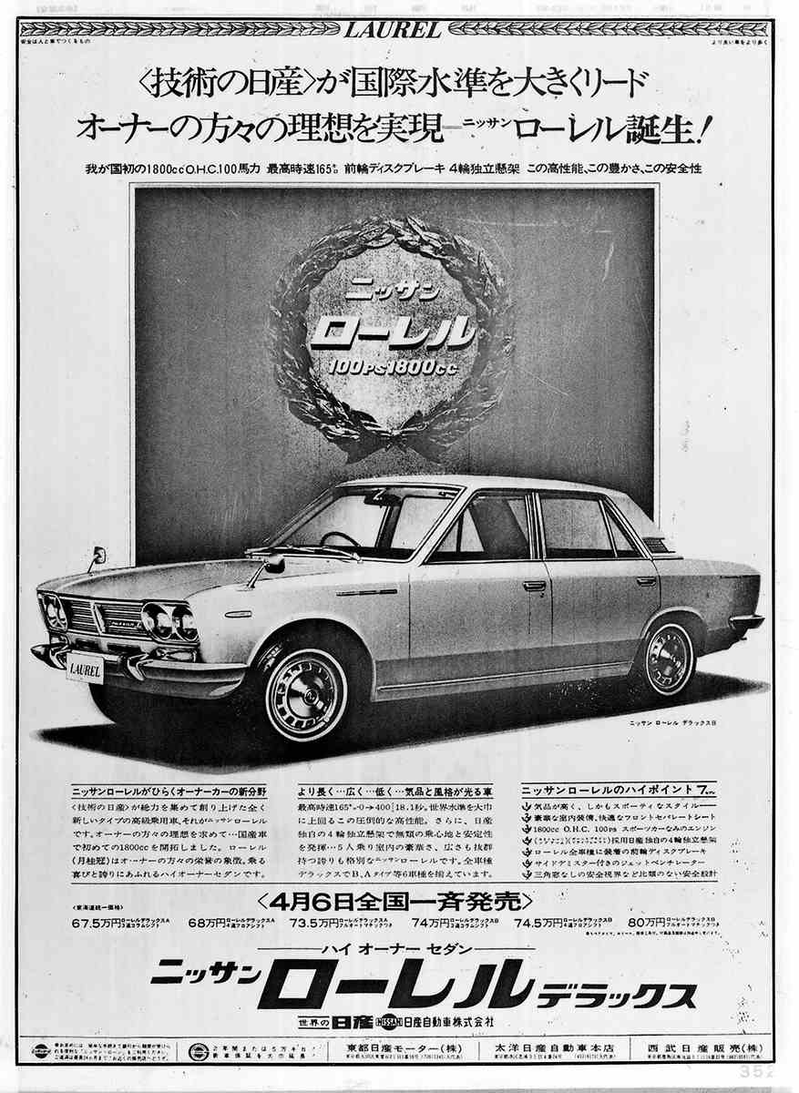
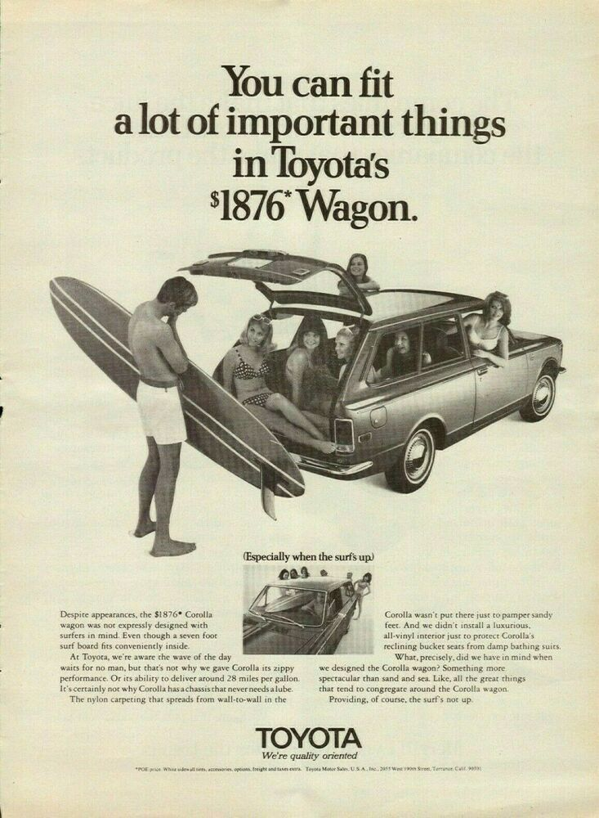

Slide 13
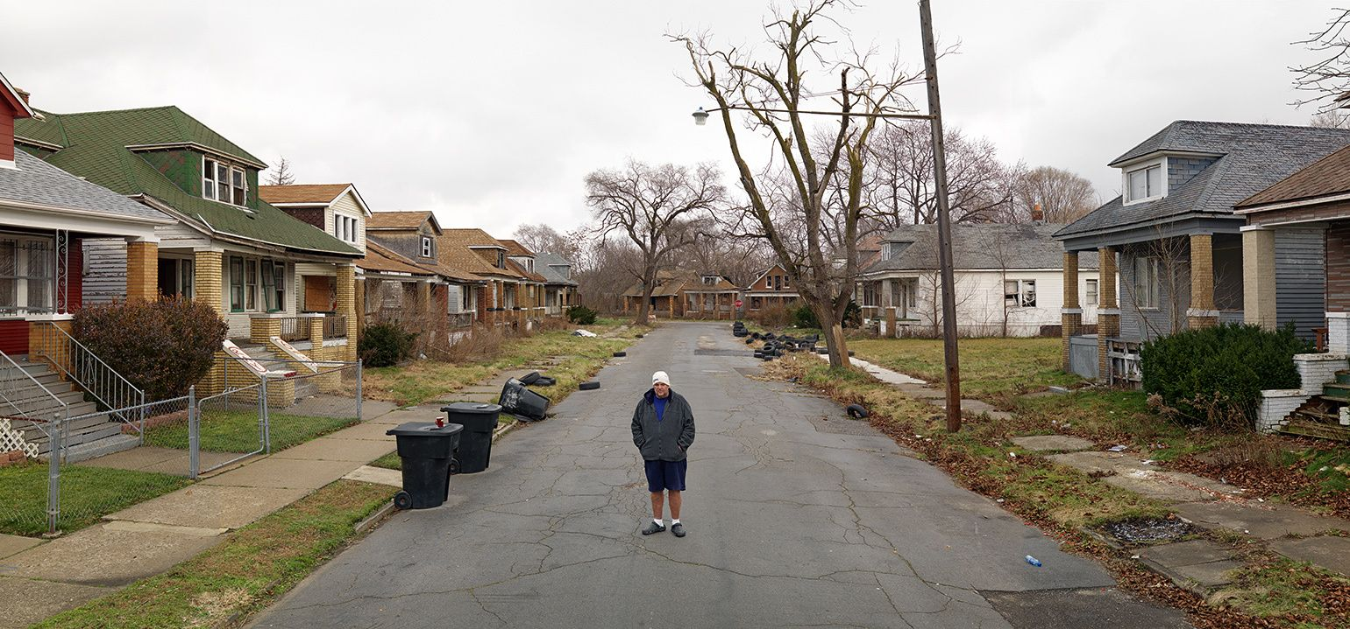
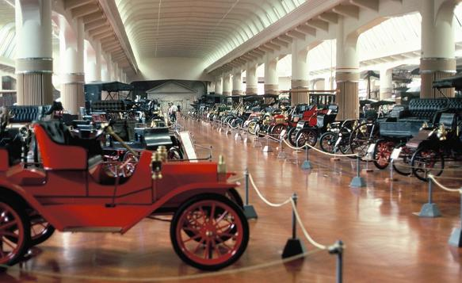
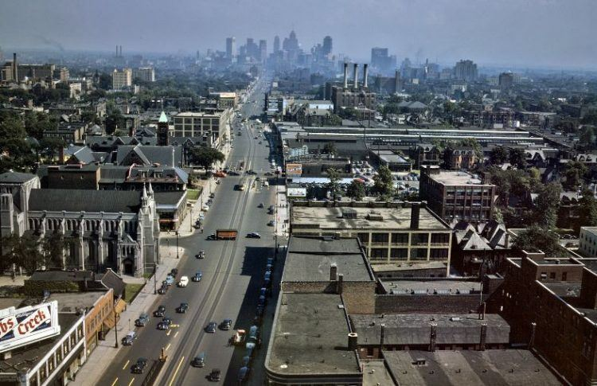


Slide 14
Detroit – The Motor City
Colegiul National de Informatica “Grigore Moisil” Brasov
Profesori coordonatori: Dragus Daiana, Stoica Catalina
Elev: Caba Matei

